Slide 1
September 20, 2023
BBBSEM x IUCG: Modernizing Making A Difference
Completing digital initiatives and post-interview outreach
Spencer Friedman, Ellie Zieper, James Stevens, Meredith Graeyer, Sankalp Koripalli, Selvana Abdelmesih

Slide 2
Agenda
1
Introduction
Meeting the Team
What is IUCG?
2
Project Goals and Methodology
Clarifying Scope of Work
Discussing Project Deliverables
3
Next Steps
Accessing Resources
Aligning Priorities

Slide 3
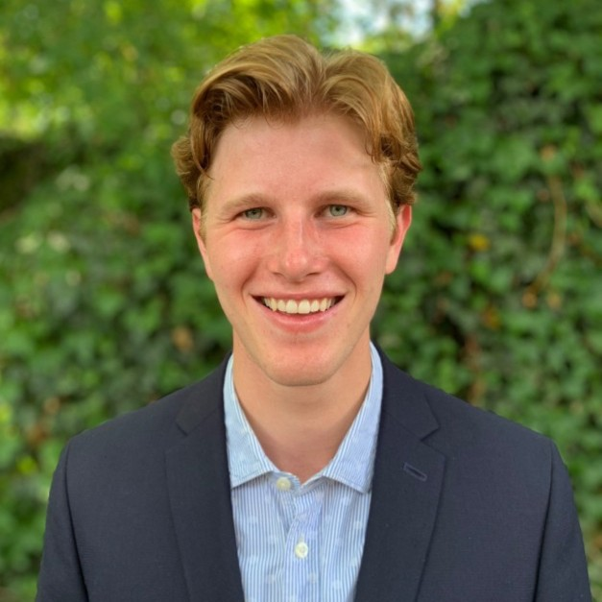
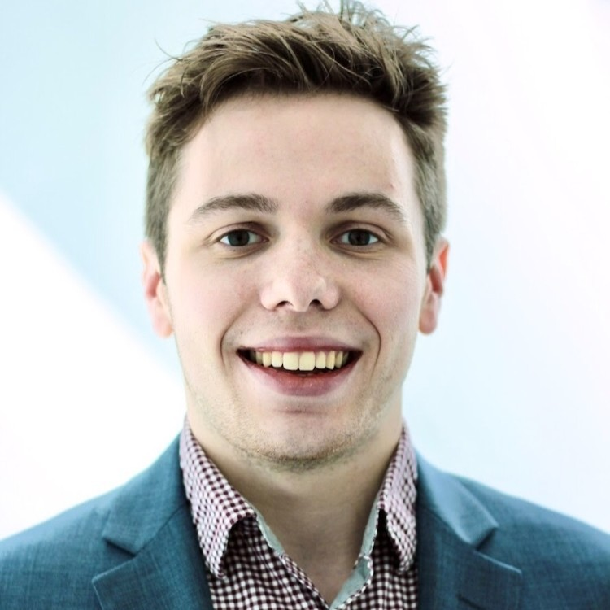
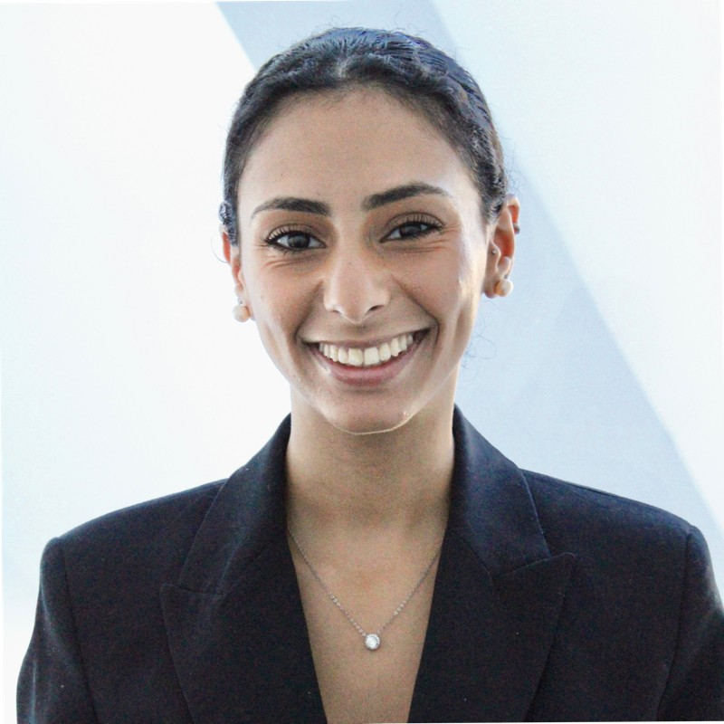

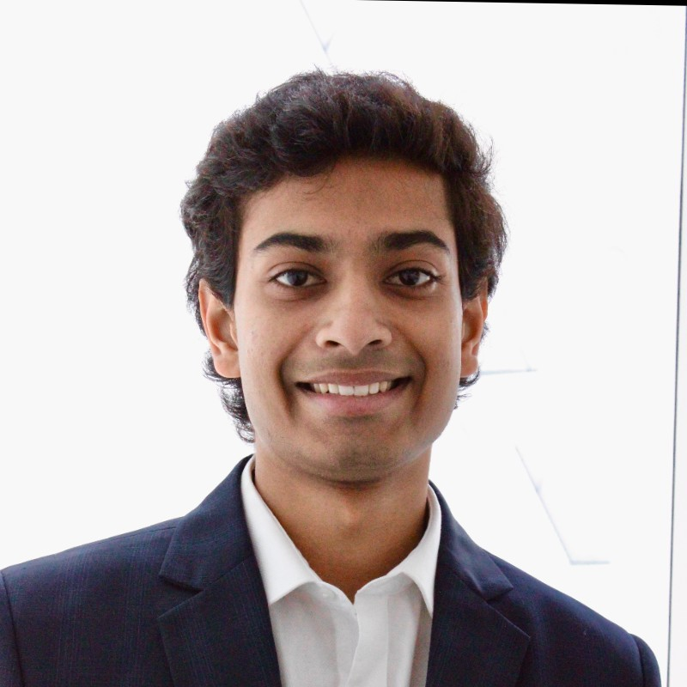
Meet The Team
Spencer Friedman
Project Manager
Informatics ‘24
James Stevens
Senior Advisor
Accounting ‘24
Selvana Abdelmesih
Analyst
Finance + Political Science ‘24
Meredith Greayer
Analyst
Mathematics ‘25
Sankalp Koripalli
Analyst
Economics ‘26

Slide 4










What is the Isenberg Undergraduate Consulting Group (IUCG)?
IUCG has a proven record of tackling new and complex problems; we are eager to apply our diverse expertise to Big Brothers Big Sisters of Eastern Massachusetts!
1
2
3
Projects
Development
Placement
IUCG has a 10-year history of providing innovative solutions to the most pressing issues faced by F500, non-profit, and start-up clients covering the following scopes:
Market Entry
Cost Saving Strategy
Higher Education Strategy
Digital Implementation
IUCG provides rigorous personal and professional development to its members via professional workshops, personal mentorship, and alumni advising.
IUCG help its members achieve roles in the careers of their dreams, whether it be strategy consulting, finance, technology, or any other fulfilling career.

Slide 5




Phase |: Review (2-3 weeks)
Areas for Improvement
Information Required to Evaluate Condition
1
Communication Process
Entire communication process
Current post-interview outreach process
2
Software Capabilities
List of software tools utilized
Noted issues with respective tools
Information transitions during pandemic
Retraced pandemic-made adjustments
3
Changes During Covid-19
Process of documenting alterations
Location of documentation storage
4
Disjoint Documentation

Slide 6




Phase |: Review (continued)
Our team aims to dive deeper within 4 key areas to better comprehend communications externally and within BBBSEM to improve its current operations
User Personalization
Knowledge Transmission
What kind of personalized communication do users want and what kinds of categorization can be done for these users?
What are the capabilities of the applications used within BBBSEM and how can they be altered to maximize efficiency?
Main Areas of Primary Intended Research
Comparable Firm Usage
Survey (Staff and Users)
How are similar companies and nonprofits achieving smooth operations and what type of software tools have proved effective for them?
How do communication bottlenecks typically manifest, what are their common causes, and what tools do the staff prefer to use for communication?

Slide 7


Phase II: Design (4-5 weeks)
Directed by Phase I findings, our team will produce a robust inventory of tools/suggestions for improved tech efficiency alongside a plan for a new volunteer post-interview outreach program.
Deliverables
Finalized flows and templates, ready for implementation
Design recommendations for each individual external communication
Defined implementation plan (including - milestones with draft timeline and risk mitigation plans)
Plan for A/B testing communication cadence and types
1
2
Modernize Communications
Create Post-Interview Outreach
Catalog efficiency improving actions, for example: outdated email and redundant SMS templates, or workflows for transition to Salesforce Flow
Perform necessary updates found through Phase I
Conceive appropriate cadence for optimal feedback rates
Draft language and best outreach practices
Suggest optimal channels for new outreach program
Gather available feedback

Slide 8


The team will utilize the next weeks to become experts in the BBBSEM communications process
In the coming weeks, the team will seek to analyze BBBSEM’s backend tools, and leverage employee feedback to expedite identification of problems and potential improvements.
Deep Dive
User Survey
The team will develop a strong understanding for BBBSEM databases and software tools
We will look to discover any inefficiencies in the current process and documentation
We will look to interview and survey employees and volunteers to learn from their difficulties
Integrate feedback into proposals for improved materials

Slide 9
Questions?

